Slide 1


Practical Data Science
Assignment #A3
LLM Text Detection
Vasileios Ilias Drouzas
Professor: Ioannis Pavlopoulos
Assistant: Konstantina Liagkou

Slide 2
Contents
Data Augmentation
Generating essays
Building text classifiers
Maximum and average similarities
Similarity scores vs prediction probabilities
Delete some generated texts
Learning Curves
Calculating accuracy
Calculating MSE
Regressor line (extending the dataset)
Regressor line (within the dataset)
Clustering
Find optimum number of clusters
Apply K-means
Yield a title per cluster
Similarities between the clusterings
Generating additional text
Retraining Random Forest

Slide 3
A. Data Augmentation
‘CARS’ use case

Slide 4
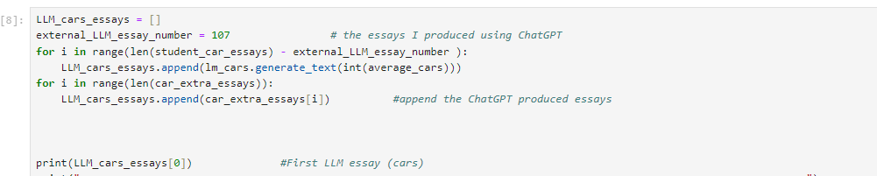
1. Generating essays
To generate the text, two ways were used:
A. Via the package
Cloning the ‘lm’ package & using the Markov module in this package
Two linear models produced, one for the ‘cars’ use case and one for the ‘cities’
Counted average number of characters in student essays for both cases, and generated essays with this number of characters
Used the generate_text() function to create texts of this size
B. ChatGPT prompting
107 essays produced by iterative prompting, for both use cases

Slide 5
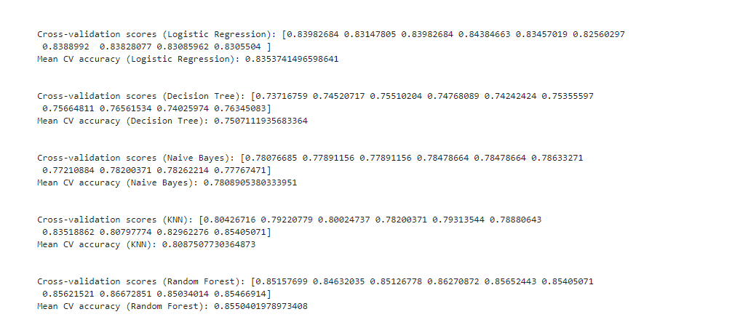
2. Build text classifiers
Here, a variety of classification algorithms were tested via cross validation.
Logistic Regression, Decision tree, Naïve Bayes, KNN(k = 10), Random Forest

Slide 6
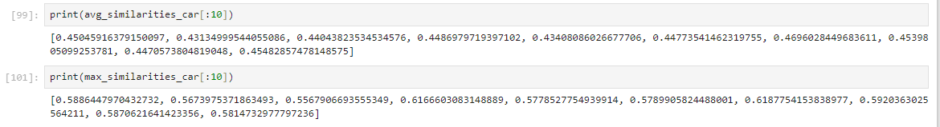
3. Maximum and average similarities
Maximum/average similarity scores between the LLM generated essays and the student essays
cosine_similarity metric
Initialized a TFIDF vectorizer and applied the fit_transform() function for the student essays (tfidf_matrix).
Iterating through the LLM essays, we took the transformed type of it (text_idf) and we calculated the cosine similarity score between the tfidf_matrix and the text_idf.
numpy.max() & numpy.mean() to find the maximum and average similarity.

Slide 7
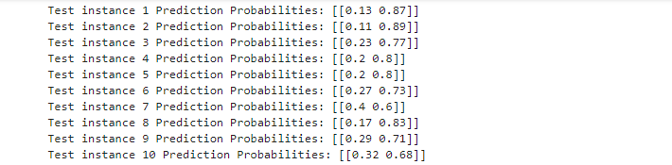
4. Similarity scores vs prediction probabilities (1/2)
tfidf_matrix included all essays
Leave-one-out-CV: Iterating the LLM essays, we kept the training indexes as a whole list of the range of all essays and in which we removed the element in the current index of the iteration (which served as the test index). So the training data were formed by using these indexes.
the labels were formed in the same way, firstly by filling 1s for the length of the LLM essays, then 0s for the student essays and discarding the current element.
After all of these, we fitted the algorithm and used the predict_proba() function to give us the prediction probabilities for every test instance (1st prob -> students, 2nd prob- > LLMs)

Slide 8
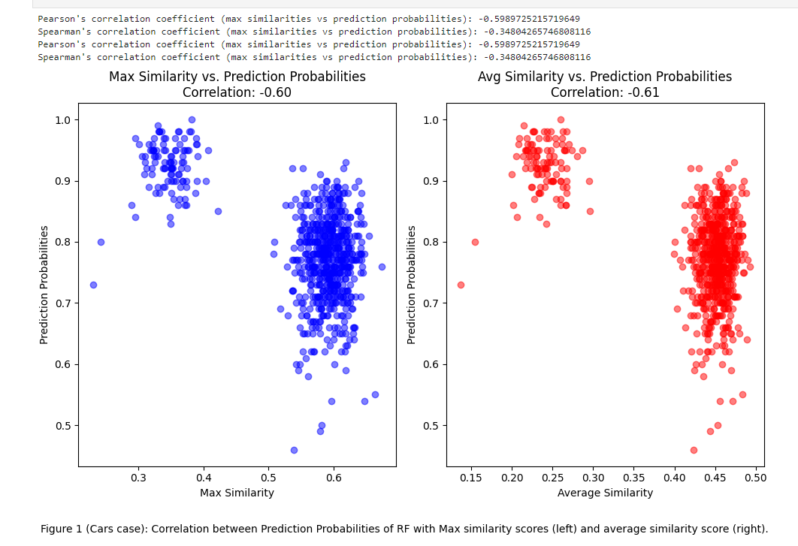
4. Similarity scores vs prediction probabilities (2/2)

Slide 9
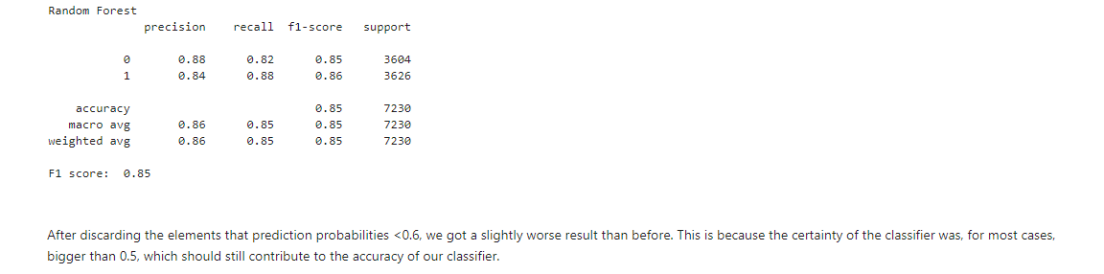
5. Delete some generated texts
Idea: Discard the generated texts that have prediction probabilities < 0.6
Slightly worse performance (sensible, since the classifier was still confident for these elements)

Slide 10
B. Learning curves
‘CARS’ use case

Slide 11
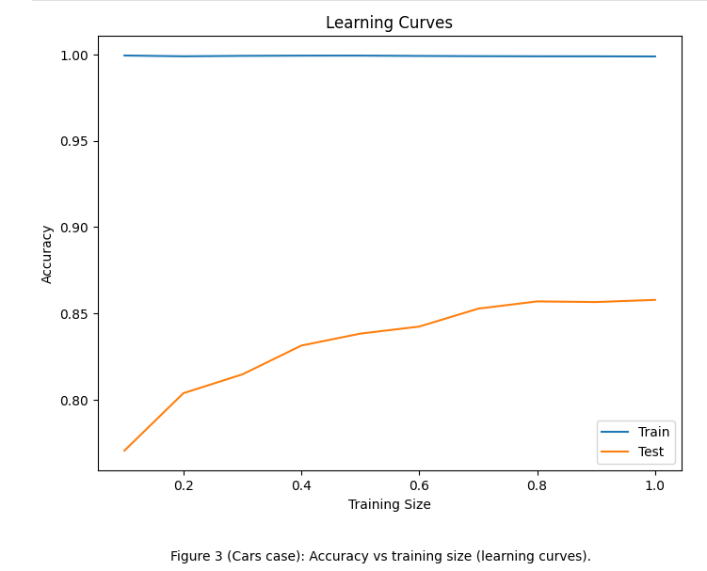
1. Calculating accuracy

Slide 12
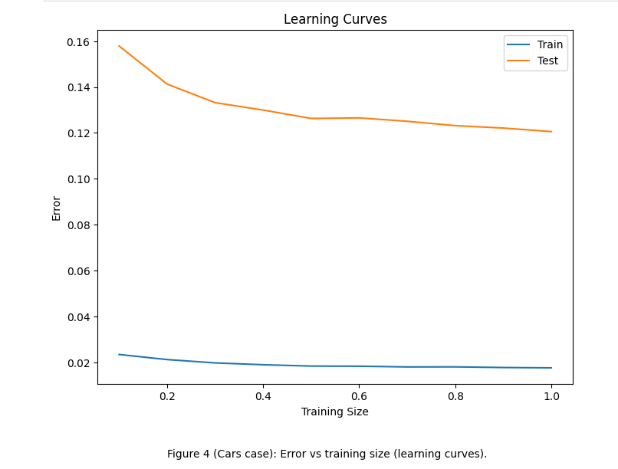
2. Calculating MSE

Slide 13
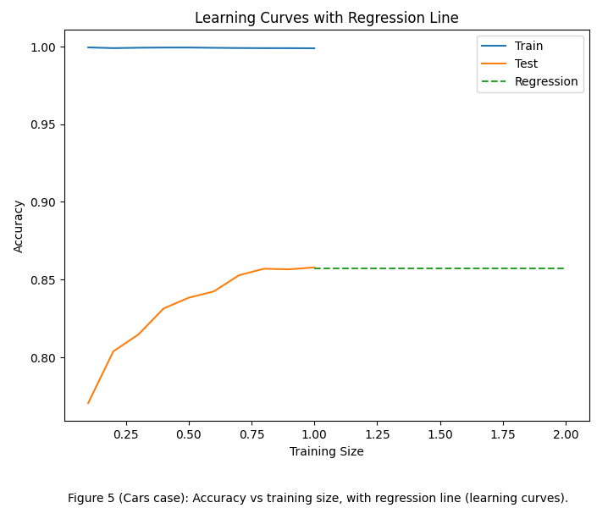
3. Regressor line (extending the dataset)
Best performance already reached within the (0,1) training range.
in (1,2) no further improvements occur.

Slide 14
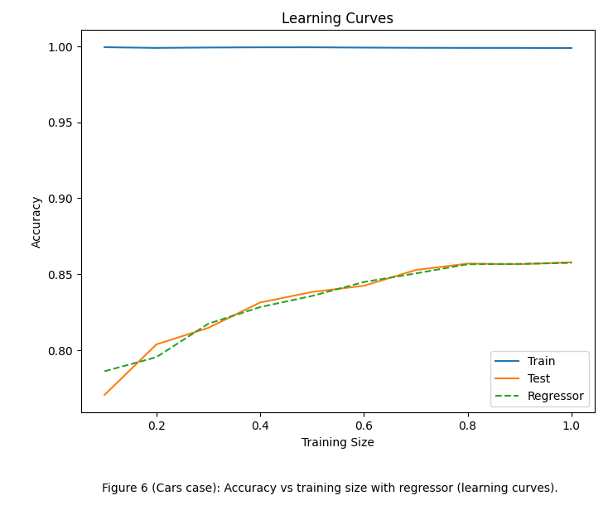
4. Regressor line (within the dataset)
The regressor line, more or less, follows our test accuracy, indicating we have reached max performance

Slide 15
C. Clustering
‘CARS’ use case

Slide 16
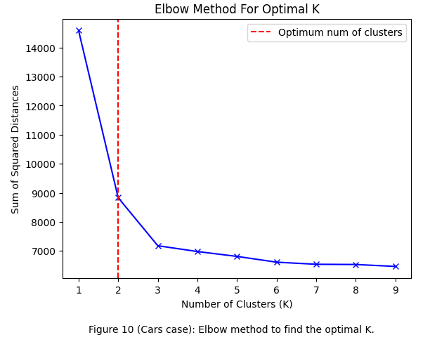
1. Find optimum number of clusters

Slide 17
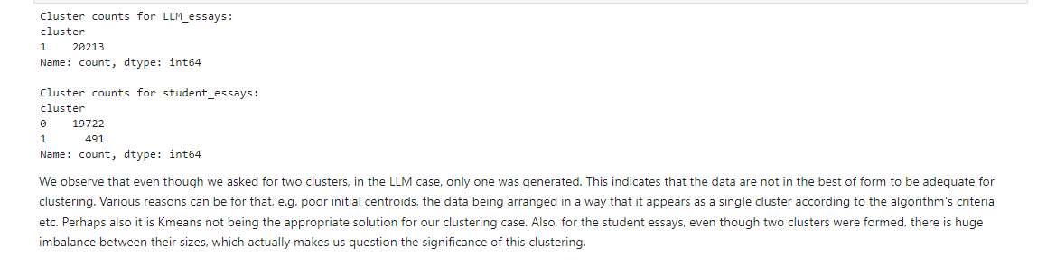
2. Apply K-means

Slide 18
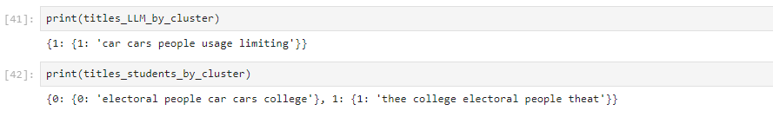
3. Yield a title per cluster
Took all the text from each cluster
Removed all the stop words (via the NLTK package)
Used regular expressions to remove also some special characters that affected our result (e.g. dots, commas).
After filtering, used the FreqDist() function and found the most common words, which formed the title for each cluster.

Slide 19
4. Similarities between the clusterings
Iterating through LLM clusterings
Using cosine_similarity metric against the student clusterings
Taking the maximum similarity
Adopting a threshold of 0.7 to determine similarity

Slide 20
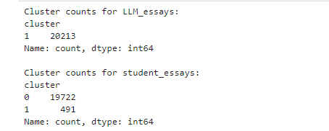
5. Generating additional text
iterated through the clusters
found the cluster with the maximum number of elements
kept the difference of elements from the current cluster and the maximum count.
Then, all we had to do was fill the remaining clusters with this difference count.
In our case, there is no difference, since we had only one cluster for the LLMs.

Slide 21
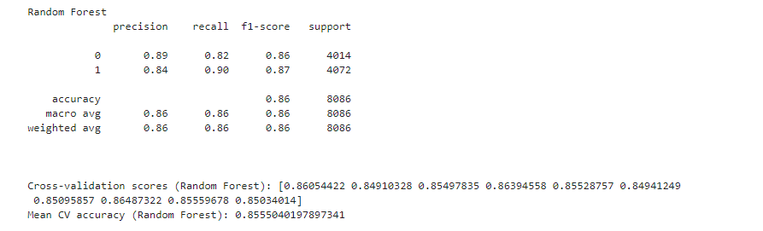
6. Retraining Random Forest
Checking the performance of our best classifier, after the clustering
Similar results

Slide 22
C. Clustering
‘Cities’ use case

Slide 23
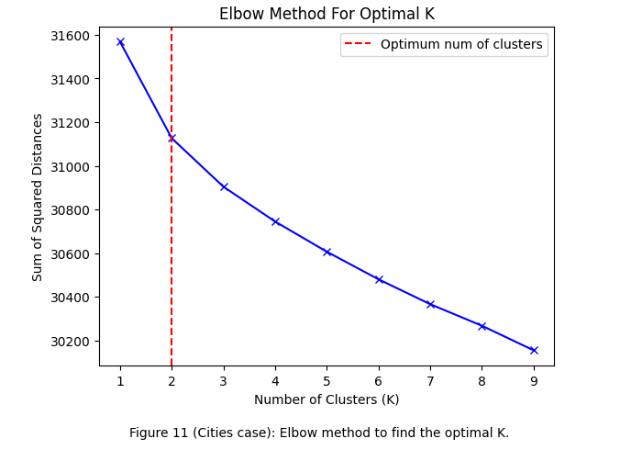
1. Find optimum number of clusters (here, clustering the sentences)

Slide 24
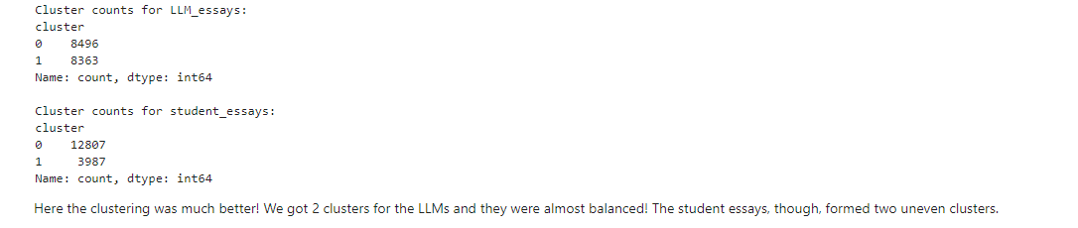
2. Apply K-means

Slide 25
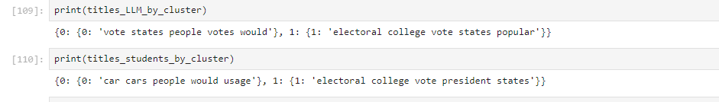
3. Yield a title per cluster
Took all the text from each cluster
Removed all the stop words (via the NLTK package)
Used regular expressions to remove also some special characters that affected our result (e.g. dots, commas).
After filtering, used the FreqDist() function and found the most common words, which formed the title for each cluster.

Slide 26
4. Similarities between the clusterings
Iterating through LLM clusterings
Using cosine_similarity_metric against the student clusterings
Taking the maximum similarity
Adopting a threshold of 0.7 to determine similarity

Slide 27
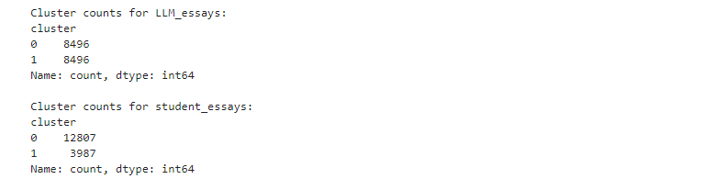
5. Generating additional text
iterated through the clusters,
found the cluster with the maximum number of elements
kept the difference of elements from the current cluster and the maximum count.
Then, all we had to do was fill the remaining clusters with this difference count.
In this case, our code worked and formed two even clusters for the LLM essays.

Slide 28
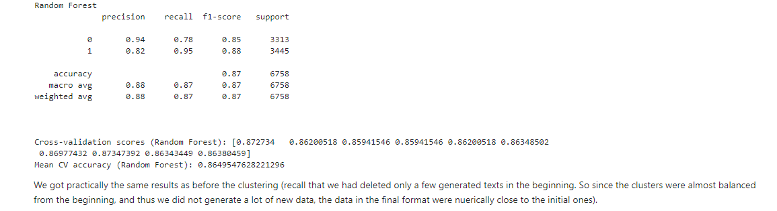
6. Retraining Random Forest
Checking the performance of our best classifier, after the clustering
Similar results

Slide 29
Recap
Random Forest wins the benchmarking test for both ‘cars’ and ‘cities’ use case.
The correlation between prediction probabilities and similarity scores is found to be negative around -0.5 for both cases.
Clustering the essays did not produce the expected results, whilst clustering the sentences worked better.
In our case, the performance of Random Forest was not practically affected by the clustering.

